Slide 1
Assignment reminders:
PLC#2 due tonight by 11:59PM
MUST be a primary (original) RESEARCH article
Duplicate submissions, incorrect formats, and late submissions will not receive credit
Group project topics due Sunday by 11:59PM
Preview the instructions for the written and oral components of this project
Work with your group to decide on a cell bio concept and related topic of interest
Upload to Canvas: Include group #, member names, cell bio concept and applied topic (be specific), and 1-3 sentences/bullet points describing how your chosen cell biological concepts relates to a topic of interest
Attend Seminar #1 and turn in question sheet Tuesday 3/27 at 4PM
Gateway Park: 60 Prescott St. Seminar room 1002
Sign-in sheet in back of room

Slide 2
Lecture 5
Chapter 5: DNA and Chromosomes
Chapter 6: DNA Replication

Slide 3
Lecture 5 Objectives
Understand and be able to explain the structure of DNA and how it serves as a mechanism of for heredity.
Understand and be able to describe the dynamic nature of chromatin structure throughout the cell cycle
Understand and be able to provide examples of how and why chromatin access is regulated
Be able to describe (with pictures) how DNA is replicated and what a replication fork looks like

Slide 4
Structure and function of DNA

Slide 5
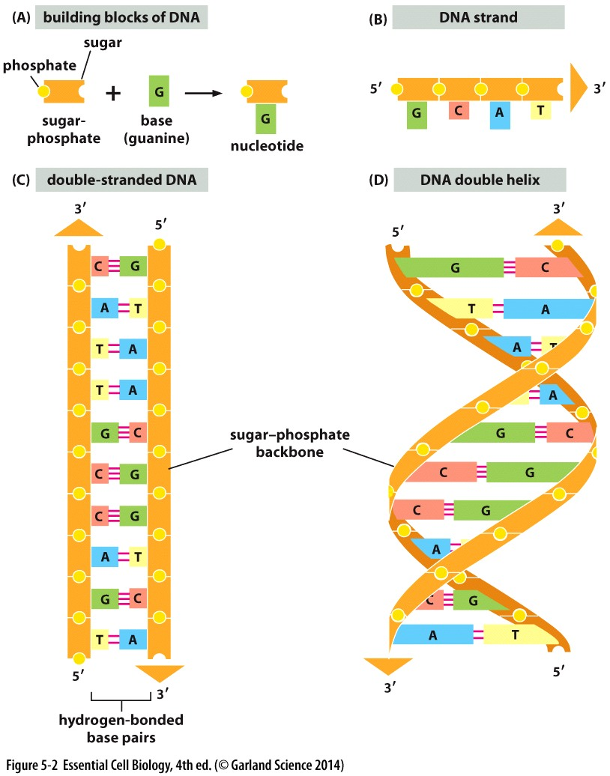
DNA molecule
Polymer of nucleotides
Each nucleotide contains:
Sugar
phosphate
base
Adenine (A)
Guanine (G)
Thymine (T)
Cytosine (C)
2 complementary strands

Slide 6
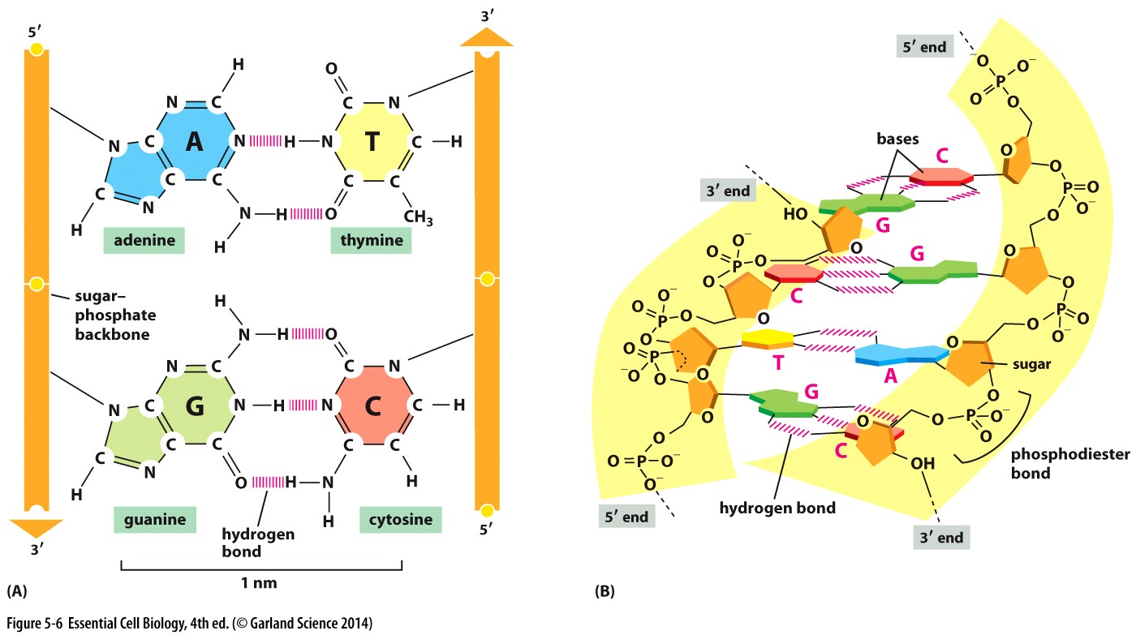
DNA molecule
Polymer of nucleotides
Each nucleotide contains:
Sugar
phosphate
base
Adenine (A)
Guanine (G)
Thymine (T)
Cytosine (C)
Nucleotides pair through hydrogen bonding
A pairs with T: 2 hydrogen bonds
G pairs with C: 3 hydrogen bonds
In a 3D DNA molecule:
Pairing happens on a flat plane
Induces a ‘twist’ in the sugar-phosphate backbone
Double helix structure results

Slide 7
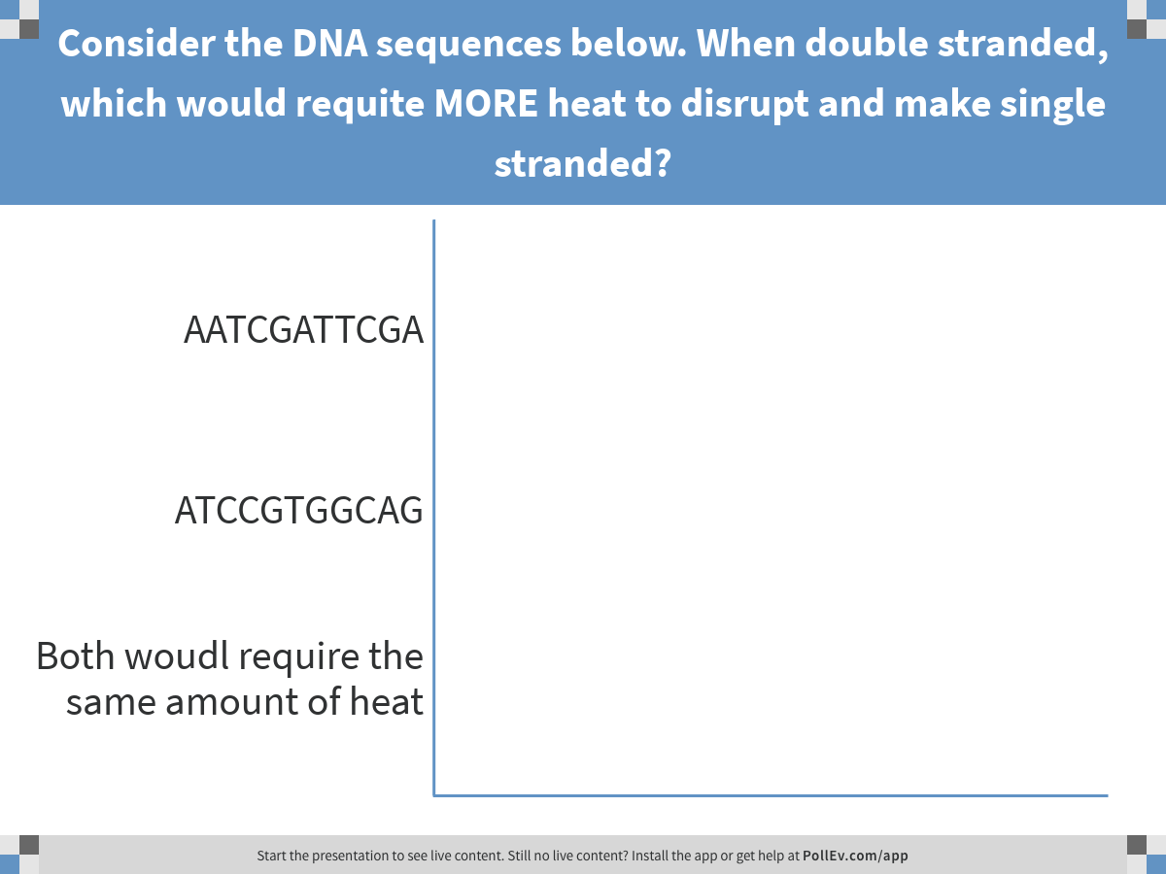
Chemical interactions, including those that hold the DNA double helix together, can be interrupted by heat.
Notes:
Consider the DNA sequences below. When double stranded, which would requite MORE heat to disrupt and make single stranded?
https://www.polleverywhere.com/multiple_choice_polls/fN7WLP7nvF96NPa

Slide 8
DNA replication

Slide 9
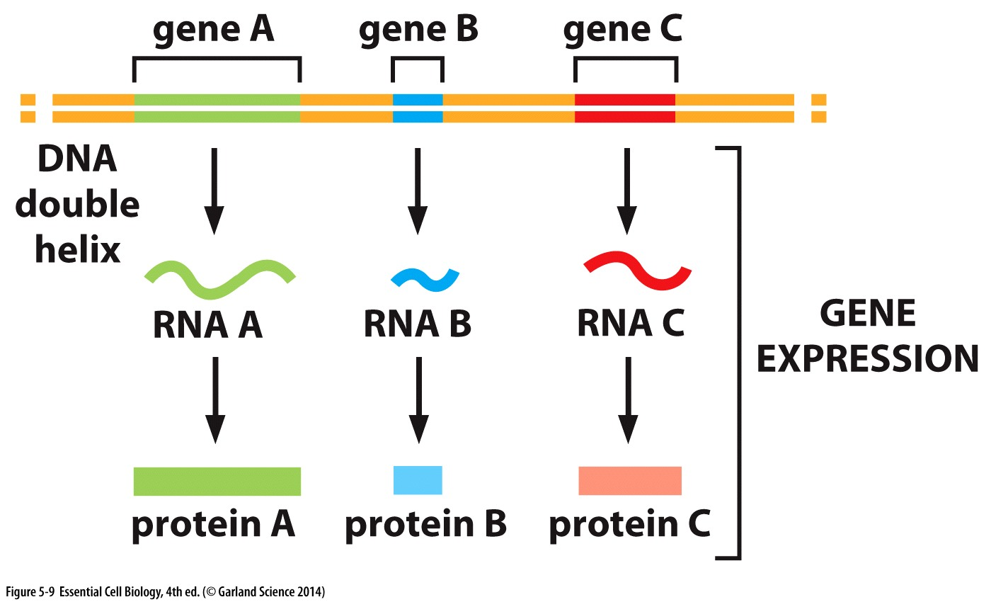
Central Dogma of Cell Biology: DNA as the blueprint
How to ensure instructions are passed
accurately to future generations?

Slide 10
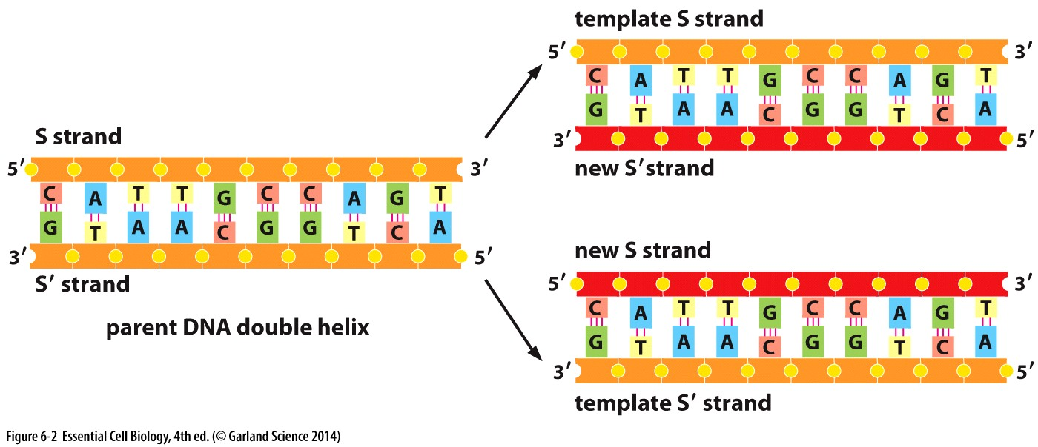
A Mechanism for Heredity
Semiconservative replication!
Identical copies passed on to daughter cells
Enabled by base pairing

Slide 11
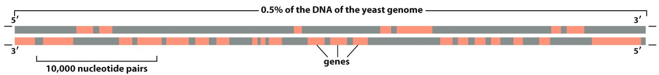
DNA encodes for more then just protein!
Genes are arranged along DNA
# of genes differs dramatically between species: Yeast have ~6,600 genes; human genome has 20,000-30,000 genes
Genes encode for RNA
Most RNA will be translated to make protein
Some RNA have other diverse functions
Function of ‘junk’ DNA between genes not well understood

Slide 12
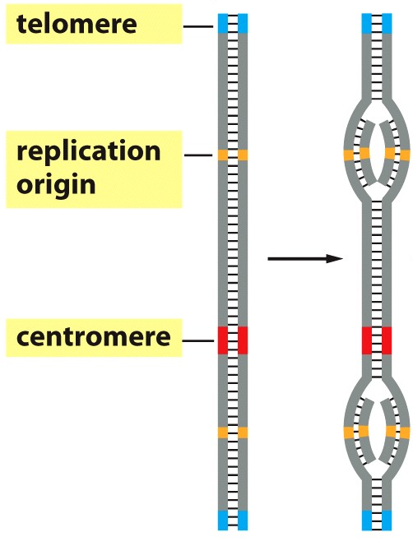
DNA encodes for more then just protein!
Specialized DNA sequences are required for
Initiation of replication (origin of replication or ORC)
Completion of replication (telomere)
Chromosome segregation during cell division (centromere)

Slide 13
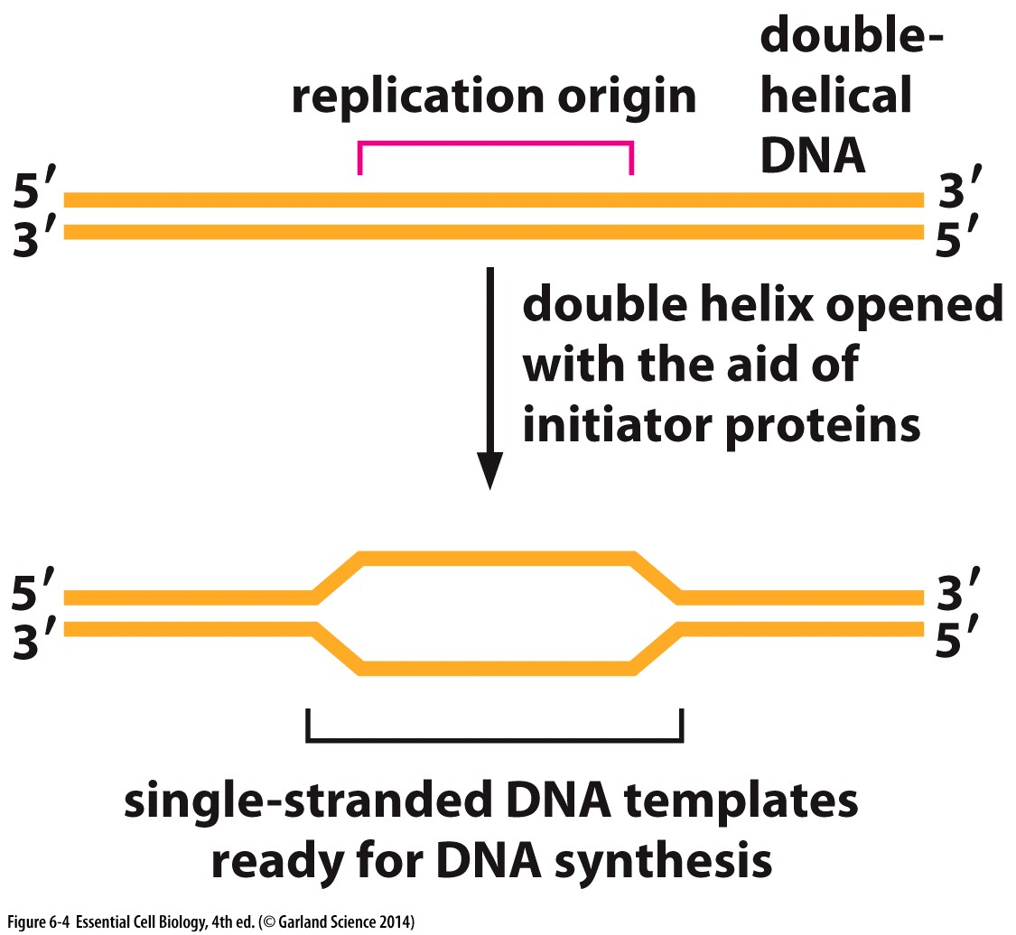
DNA Replication
Begins at an ORC (origin of replication)
Enzymes denature (‘unzip’) the double strand
Reduce activation energy needed to break H-bonds between bases of nucleotides
TWO replication forks

Slide 14
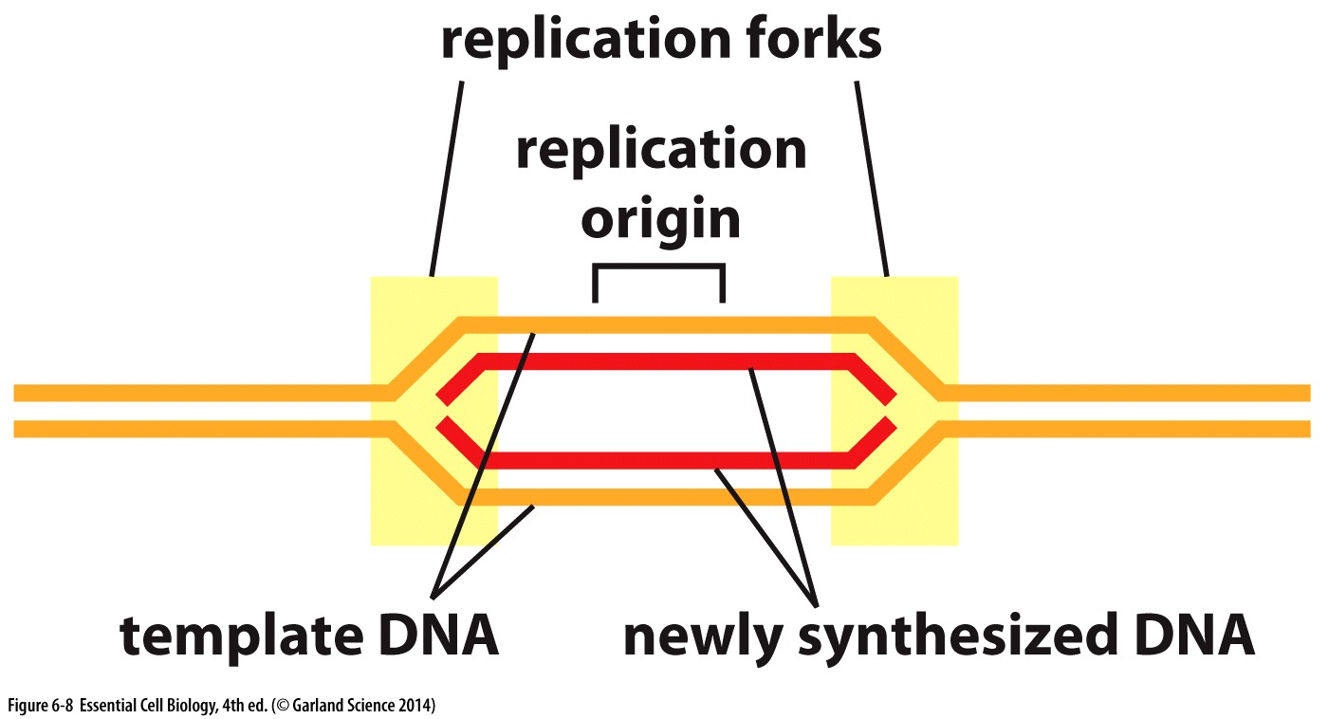
DNA Replication
Begins at an ORC (origin of replication)
Enzymes denature (‘unzip’) the double strand
Reduce activation energy needed to break H-bonds between bases of nucleotides
TWO replication forks

Slide 15
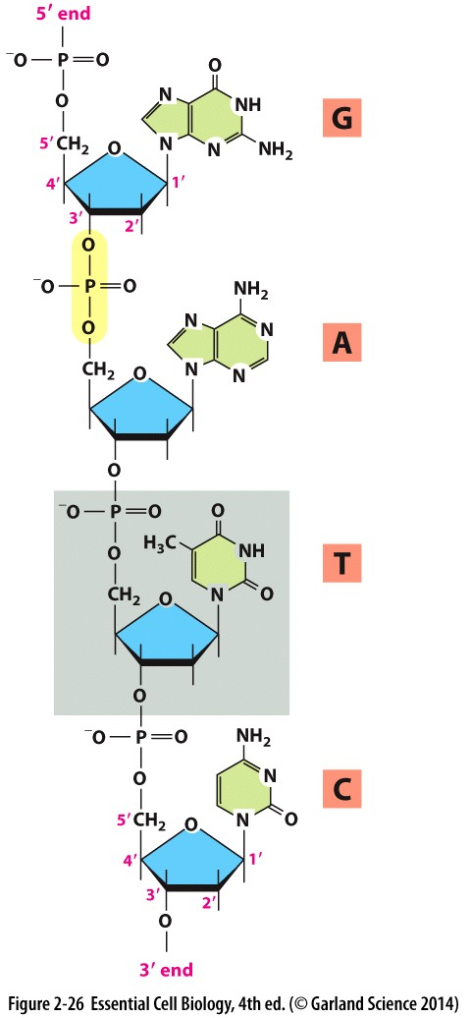
DNA grows 5’ to 3’
#1
Phosphodiester bonds to join nucleotides together exclusively add the new nucleotide at the 3’ Carbon
#2
#3
#4

Slide 16
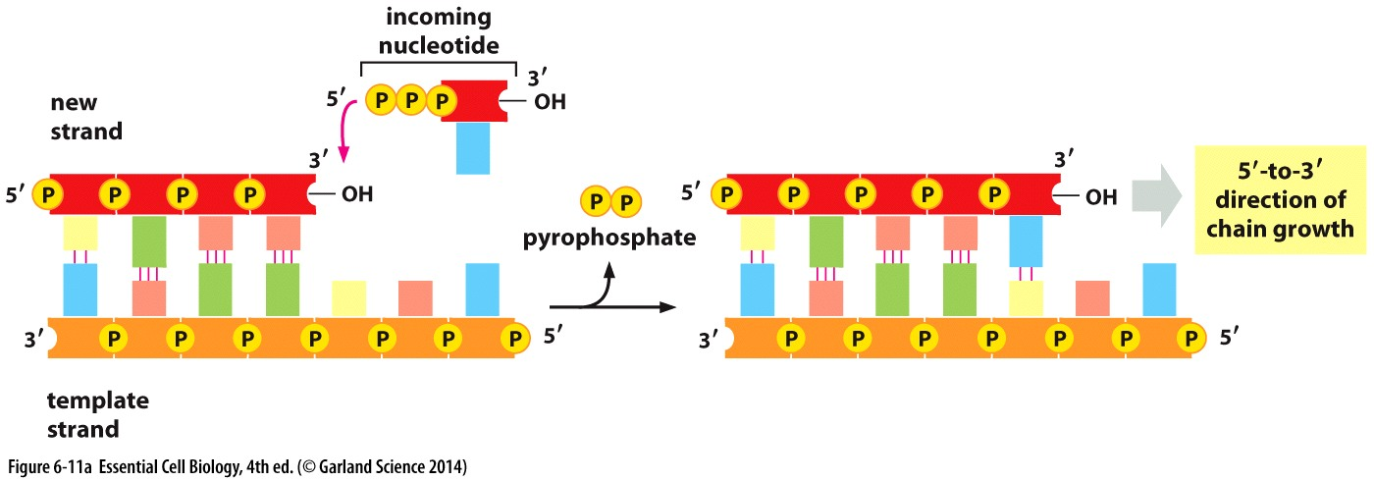
DNA grows 5’ to 3’
Phosphodiester bonds to join nucleotides together exclusively add the new nucleotide at the 3’ Carbon
DNA is replicated 5’→3’ direction
Polymerase: enzyme that catalyzes the addition of nucleotides

Slide 17
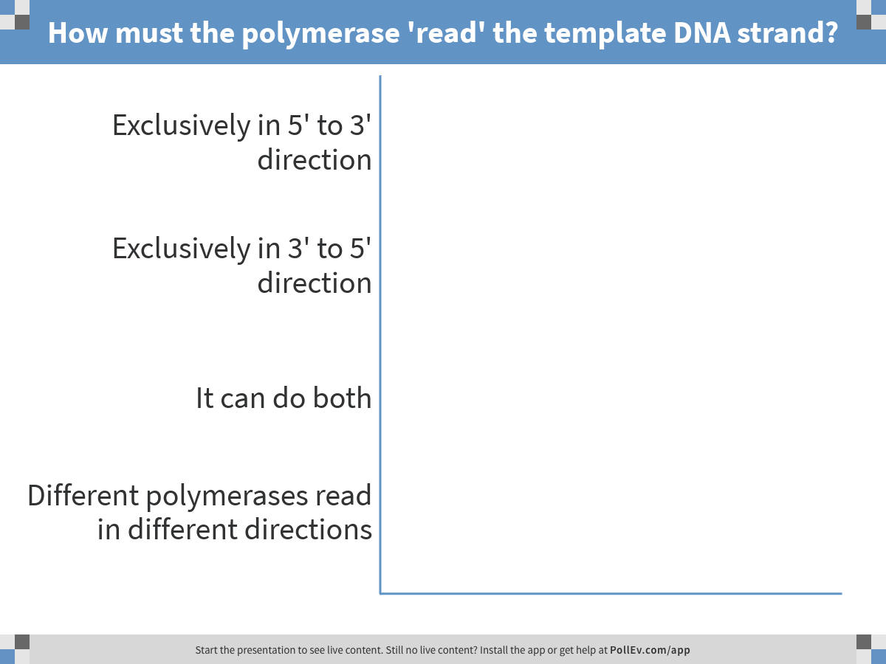
Considering that DNA grows 5’ to 3’….
Notes:
How must the polymerase 'read' the template DNA strand?
https://www.polleverywhere.com/multiple_choice_polls/RJaSMxin2IgcW0I

Slide 18
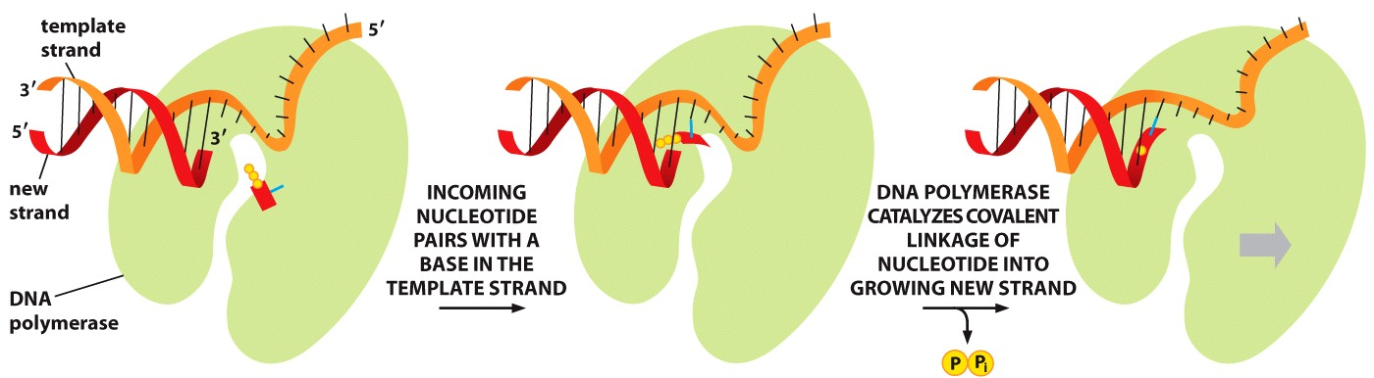
DNA grows 5’ to 3’
Phosphodiester bonds to join nucleotides together exclusively add the new nucleotide at the 3’ Carbon
DNA is replicated 5’→3’ direction
Polymerase reads the DNA template in the 3’→ 5’ direction
New nucleotide to be added

Slide 19
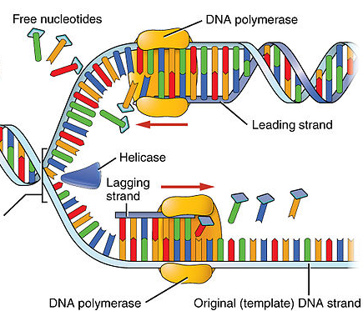
Asymmetry at the replication fork
Because DNA polymerizes exclusively 5’ to 3’:
Polymerization at each replication fork goes in two directions
Leading strand is continuous and grows TOWARDS the unwinding template at the replication fork
Lagging strand grows away from the replication fork

Slide 20
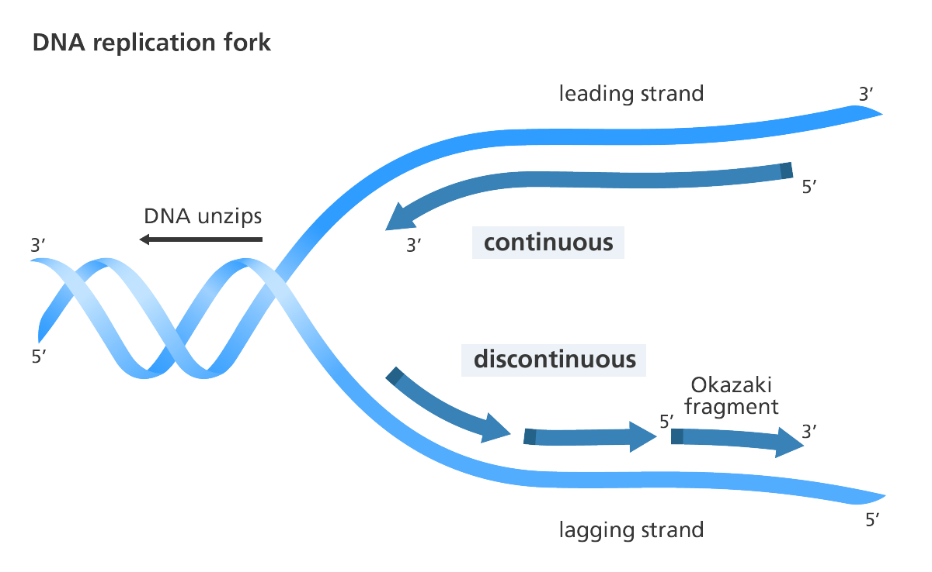
Asymmetry at the replication fork
Because DNA polymerizes exclusively 5’ to 3’:
Polymerization at each replication fork goes in two directions
Leading strand is continuous and grows TOWARDS the unwinding template at the replication fork
Lagging strand grows away from the replication fork
Replication of the lagging strand is discontinuous
Polymerizes in fragments called okazaki fragments

Slide 21
There are TWO replication forks at each ORC
What would this look like?
Where are the 5’ and 3’ ends of the template (parental) DNA?
Where are the 5’ and 3’ ends of the new (daughter) DNA?
Where would the lagging strand and okazaki fragments be?
Can you draw it? (without using the text or internet!)

Slide 22
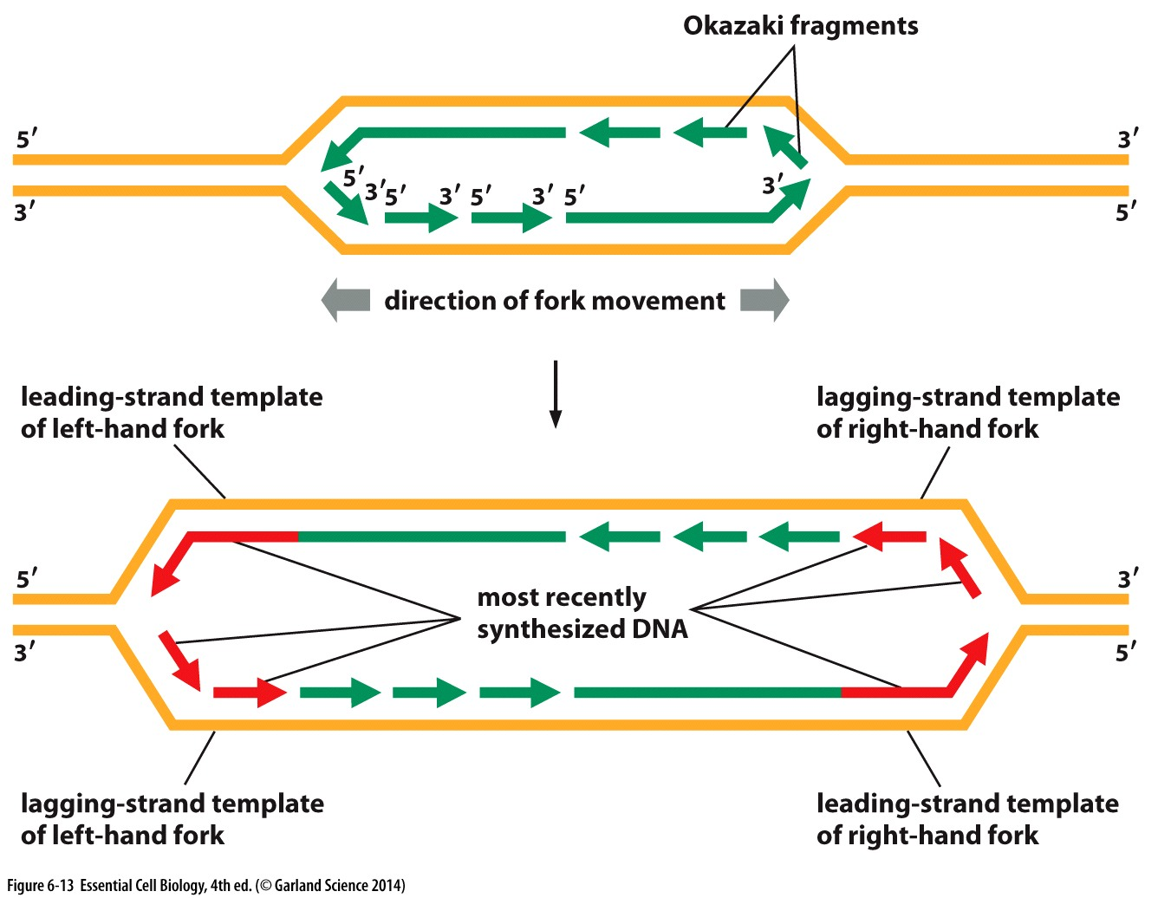

Slide 23
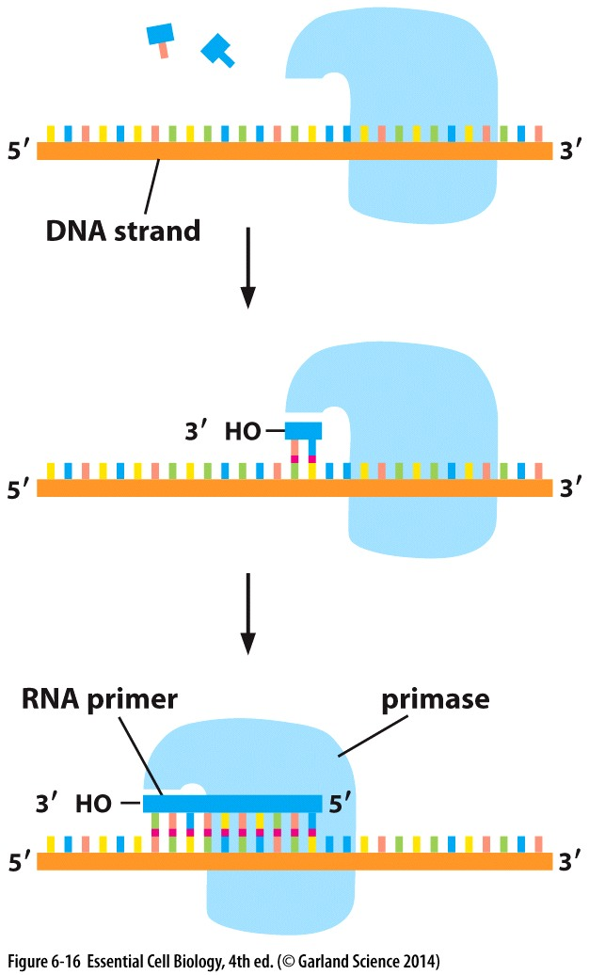
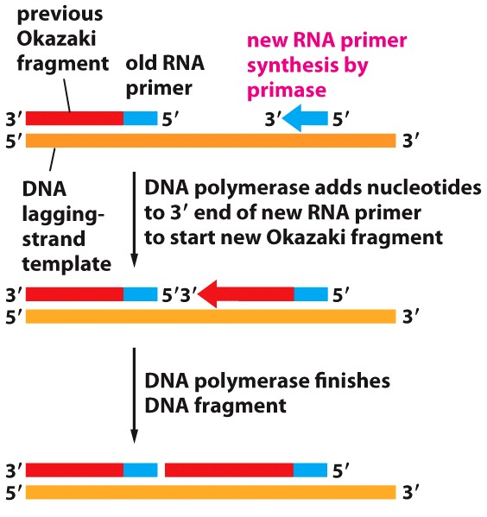
RNA primers to initiate replication
DNA polymerase needs a nucleotide polymer (a “free end”) to build on
Short sequences of RNA serve this function and ‘prime’ the polymerase to replicate

Slide 24
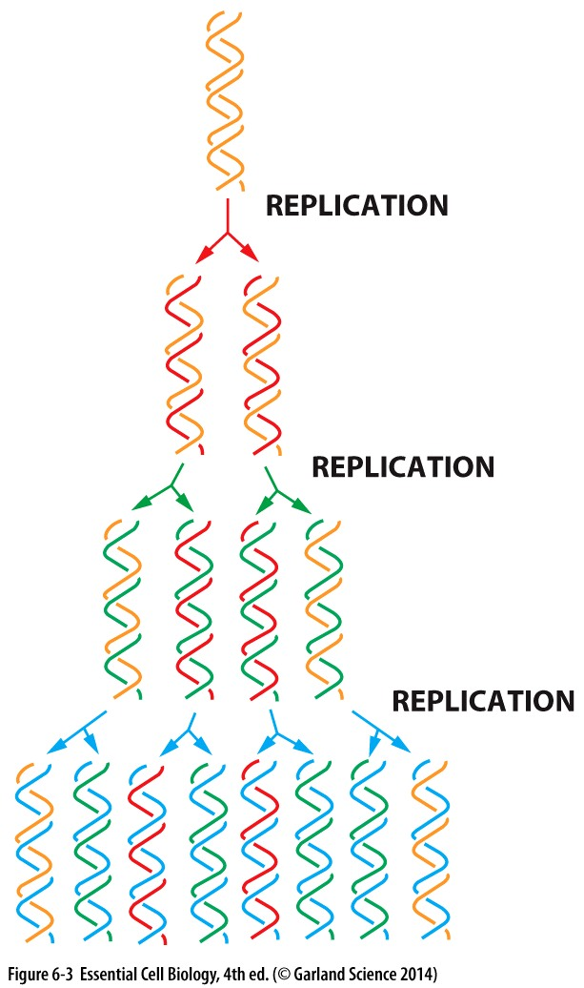
A Mechanism for Heredity
Semiconservative replication!
Enabled by base pairing
‘old’ strand serves as a template
‘new’ strand is made to complement ‘old’ strand
Essential that DNA is copied correctly
any errors will be passed on during subsequent rounds of replication

Slide 25
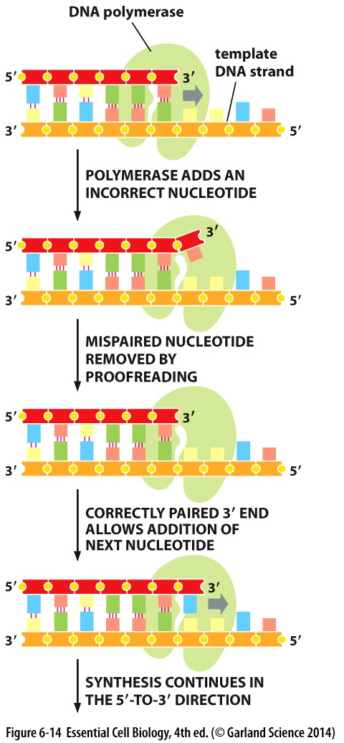
Mistakes would be disastrous!
Changes in DNA sequence impact protein sequence/structure/function…
DNA polymerase is very accurate and rarely makes mistakes
1:10,000,000 nucleotides
DNA polymerase has an error correction function
Enzymes can catalyze reactions in both directions → can add or remove nucleotides

Slide 26
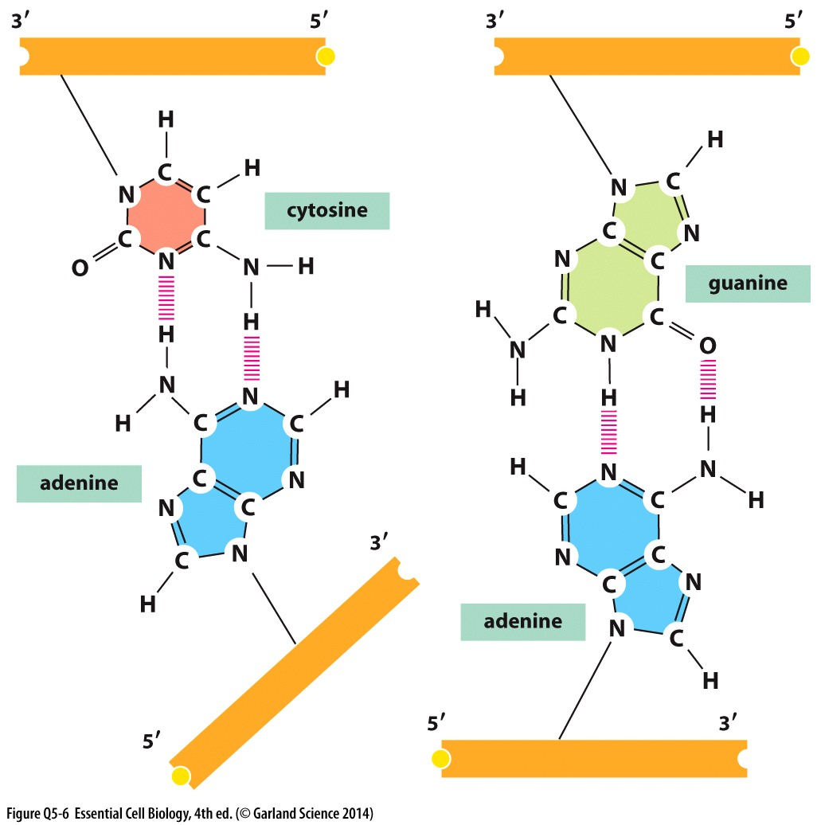
Proper base pairing is essential for semiconservative replication…
But other base pairs form just as many Hydrogen bonds. Why might these be disfavored?
Incorrect Pairing
Correct Pairing

Slide 27
Structure and organization of chromatin

Slide 28
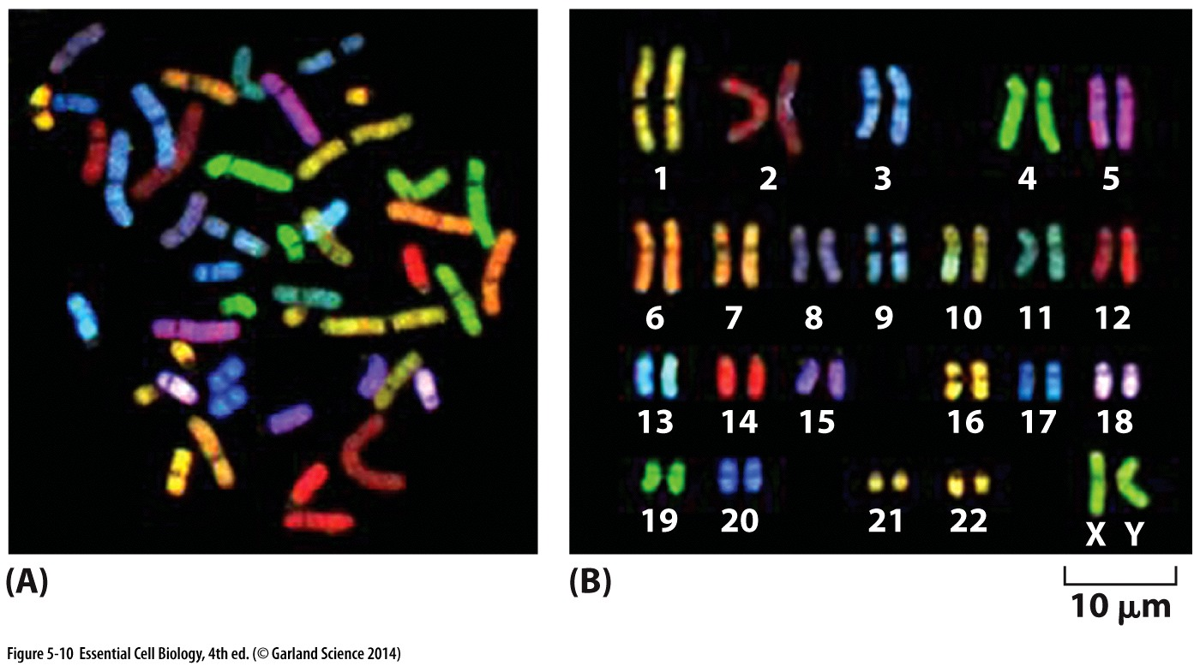
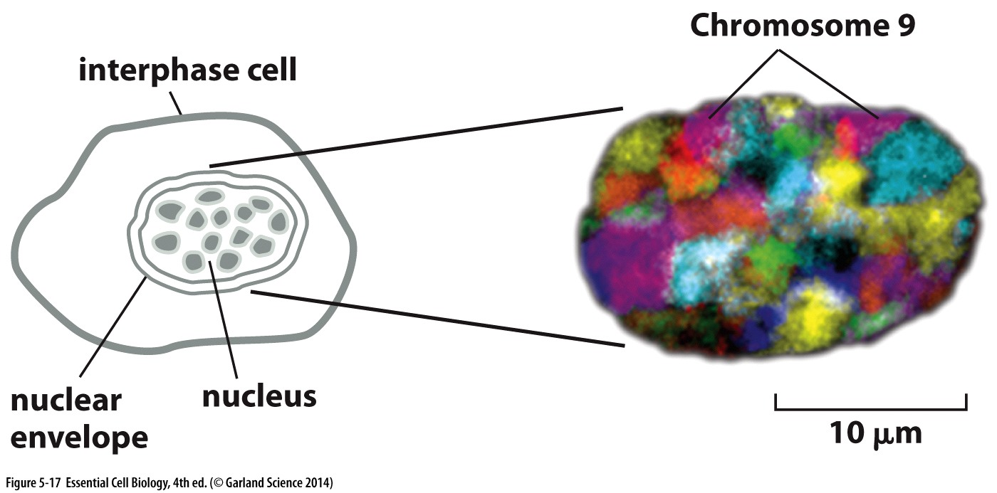
DNA is organized into chromosomes
Chromosome: linear DNA molecule that is extremely well packaged by protein
DNA + packaging protein = chromatin
In humans:
23 PAIRS of chromosomes
Numbered according to size, except for the sex determinant chromosomes (x&y)
Alleles: versions of the same chromosome or gene- one paternal, one maternal
Interphase chromatin is organized, not randomly distributed

Slide 29
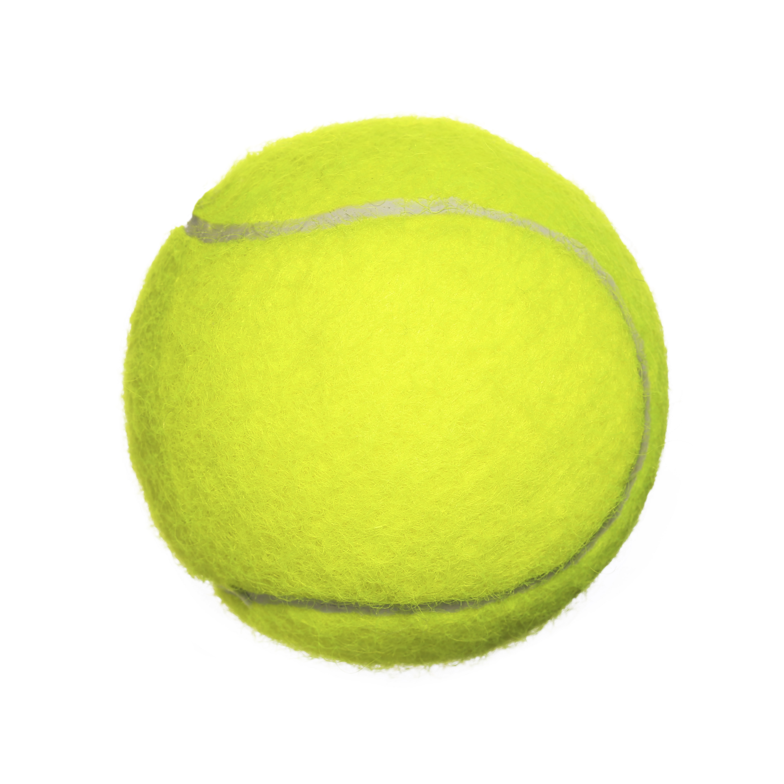
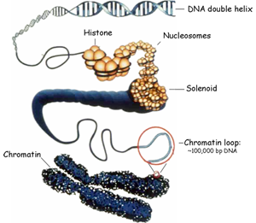
a LOT of genetic information
A human cell has ~2m of DNA
All the DNA in all your cells would stretch TWICE the width of the solar system
A nucleus is only about 6μm = 0.000006m wide
like packing 24 miles of thread into a tennis ball
How does it fit?
Layer upon layer of organization!

Slide 30
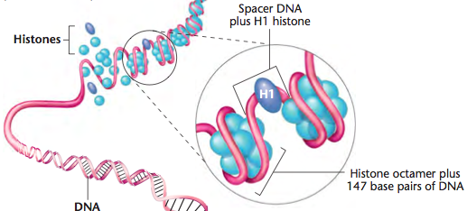
Nucleosomes
Basic unit of chromosome structure
Chromatin is wrapped around an octamer of proteins known as histones histones + DNA = nucleosome
A 5th histone (H1)
binds the ‘linker
region’ between
nucleosomes →
chromatin fiber
Histones are essential and the most highly conserved proteins between species

Slide 31
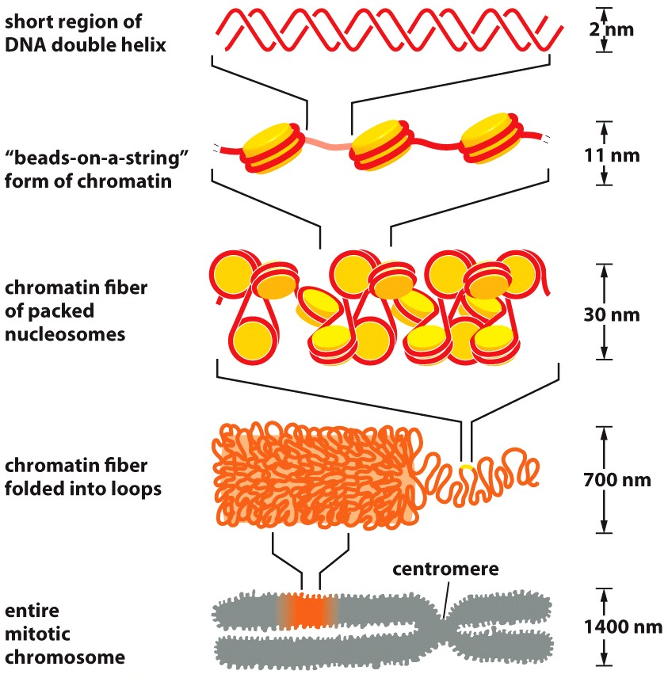
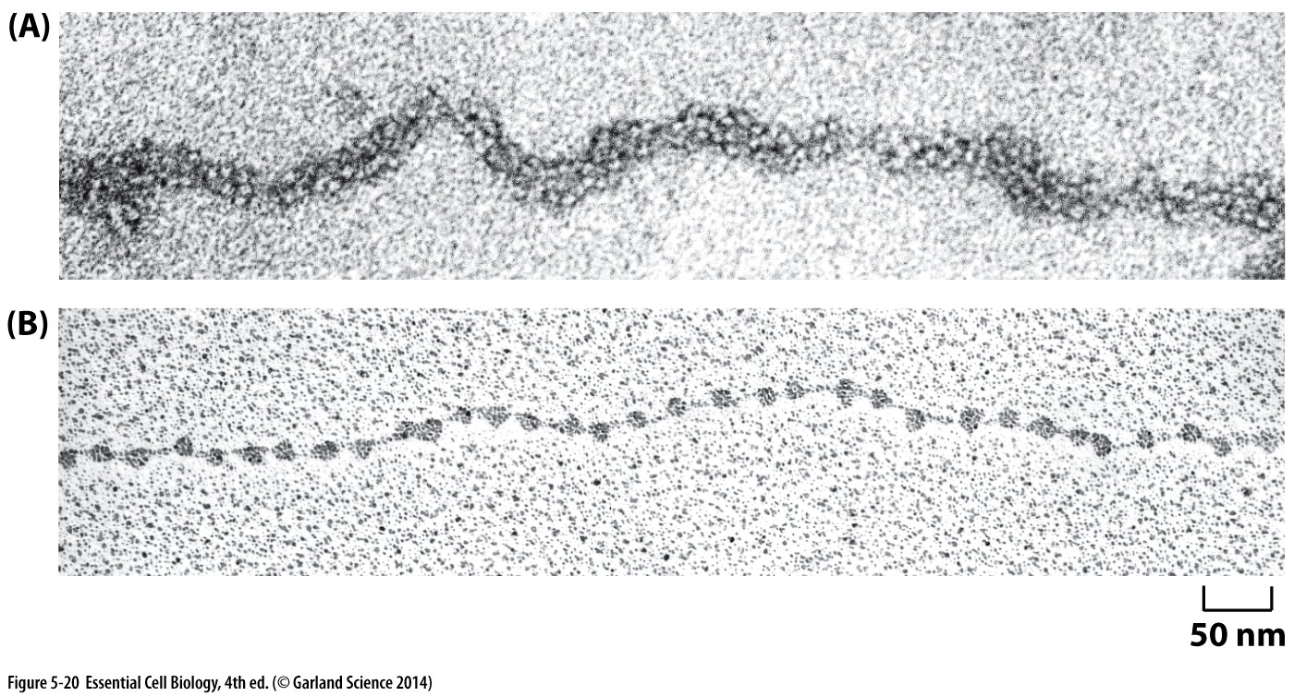
Imaging chromatin
Electron Microscopy to see chromatin

Slide 32
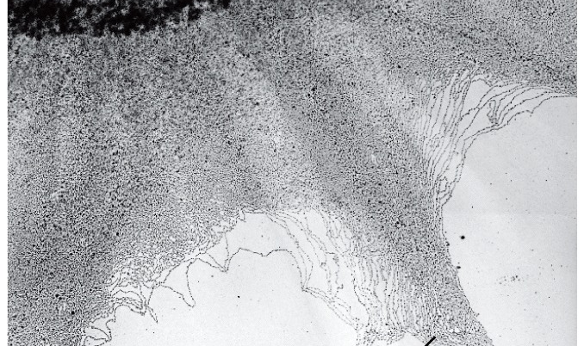
DNA in chromosomes is always highly condensed
Chromatin fibers spilling out of a broken nucleus

Slide 33
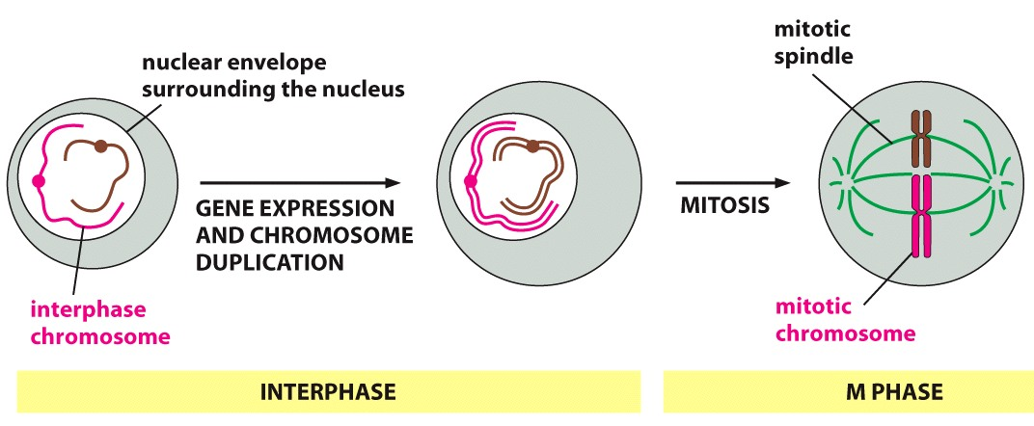
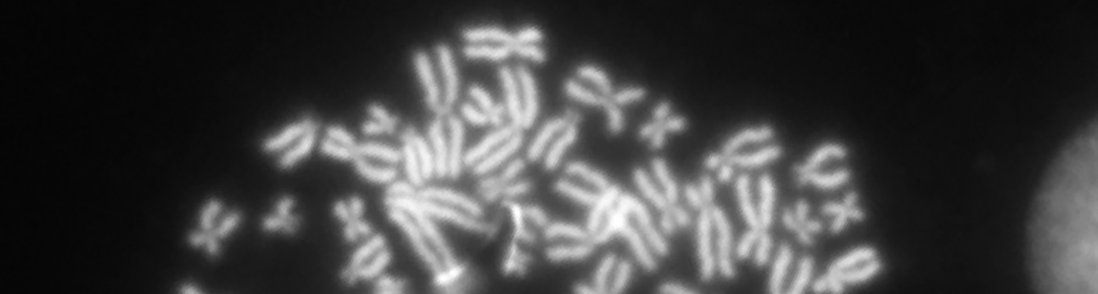
Condensation for cell division
Dramatic changes in chromosome condensation mark the onset of mitotic cell division

Slide 34
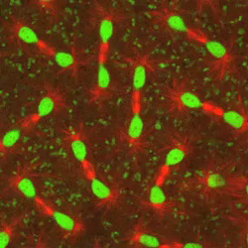
Chromatin structure is Dynamic

